Slide 1
Multiplayer Yahtzee
The A Team:
A®
Joshua Venable, Tyler Ciapala-Hazlerig, Maalik Brown

Slide 2
Project Overview
Local-multiplayer implementation of Yahtzee
Number of players that will be playing the game
Each player can choose a name
Rotate turn by turn
The main view is updated for next player
Rotation of players until game end
Notes:
Josh

Slide 3
Project Requirements
Modified Tyler's game to be multiplayer by addding:
GameControl
Player
GameWindow
Non-functional
Game configuration
Player list
Notes:
Josh

Slide 4
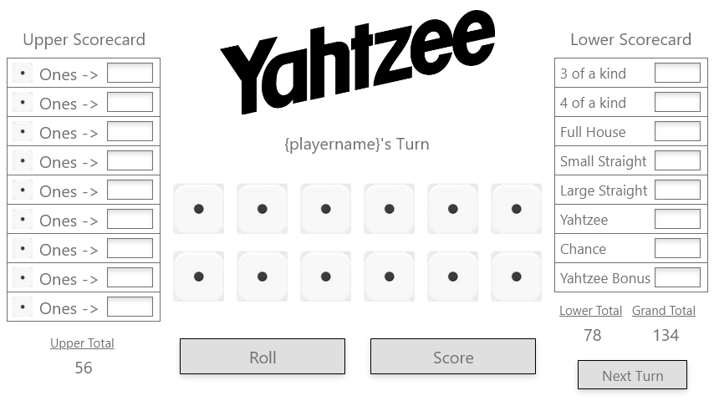
Planning
Create multiple players
Create turn cycle
Create GUI for multiple players
Notes:
Tyler
We began the project by coming up with a list of changes that needed to be made from my version of Yahtzee. We choose to start from my version because I designed my single player version to be as compatible with multiplayer as possible. Given how I created my original version we concluded that all we needed to do to make it multiplayer was create some sort of player object, cycle through that player object as the turns passed by, and create a more generic player view that is displayed unique to each player.
During the planning phase we also outlined certain workflows such as how we were going to report issues to each other, assign tasks when they arose, and use our repo. We mostly stuck to the rules we set however I was unable to implement them into the git workflow because of how GitHub classroom set up the repo permissions.
Finally, before we started coding, I created a wireframe layout of what we wanted the final GUI to look like. There were a few changes in the actual implementation, mostly because time prevented us from exactly copying our plan.

Slide 5
Project Solution Approach
Major Components
Player
Hand
Scorecard including scoring
Game/UI features identified and worked on
Hand/Die
Player
Upper/Lower Sections
Configurations
Notes:
Josh

Slide 6
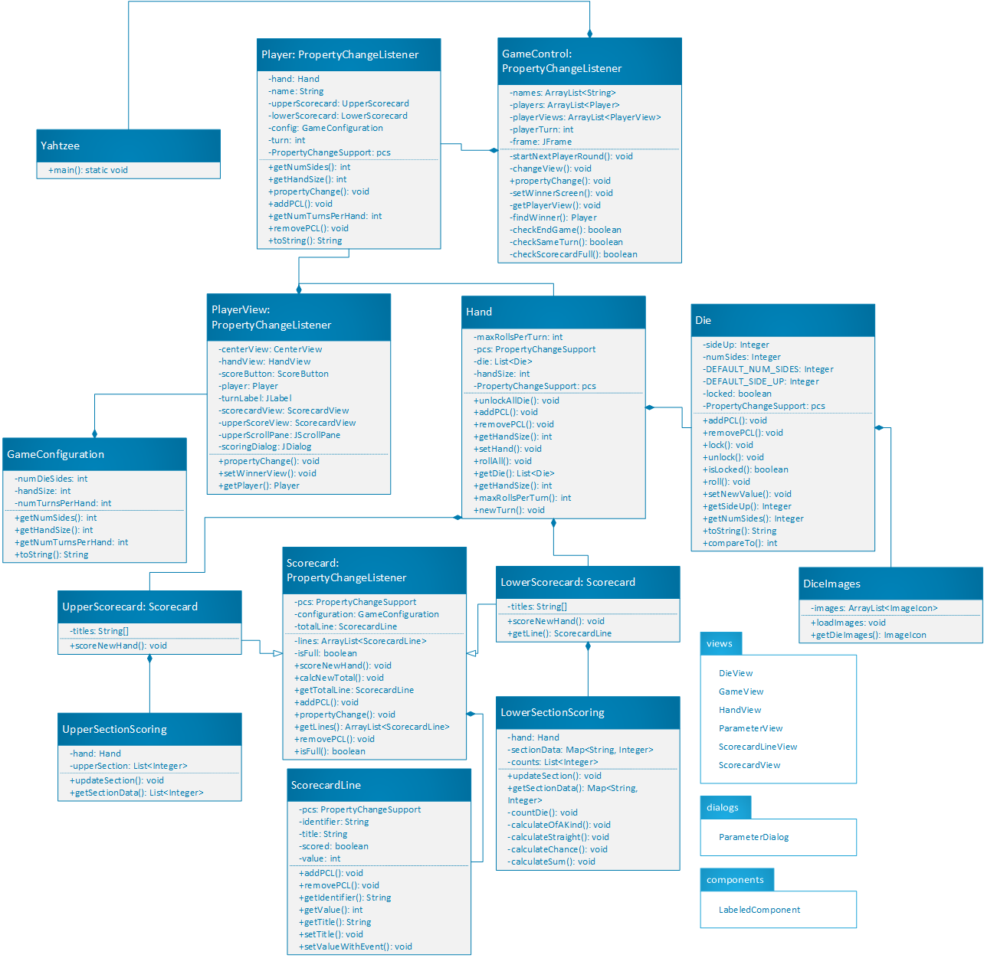
Notes:
Tyler

Slide 7
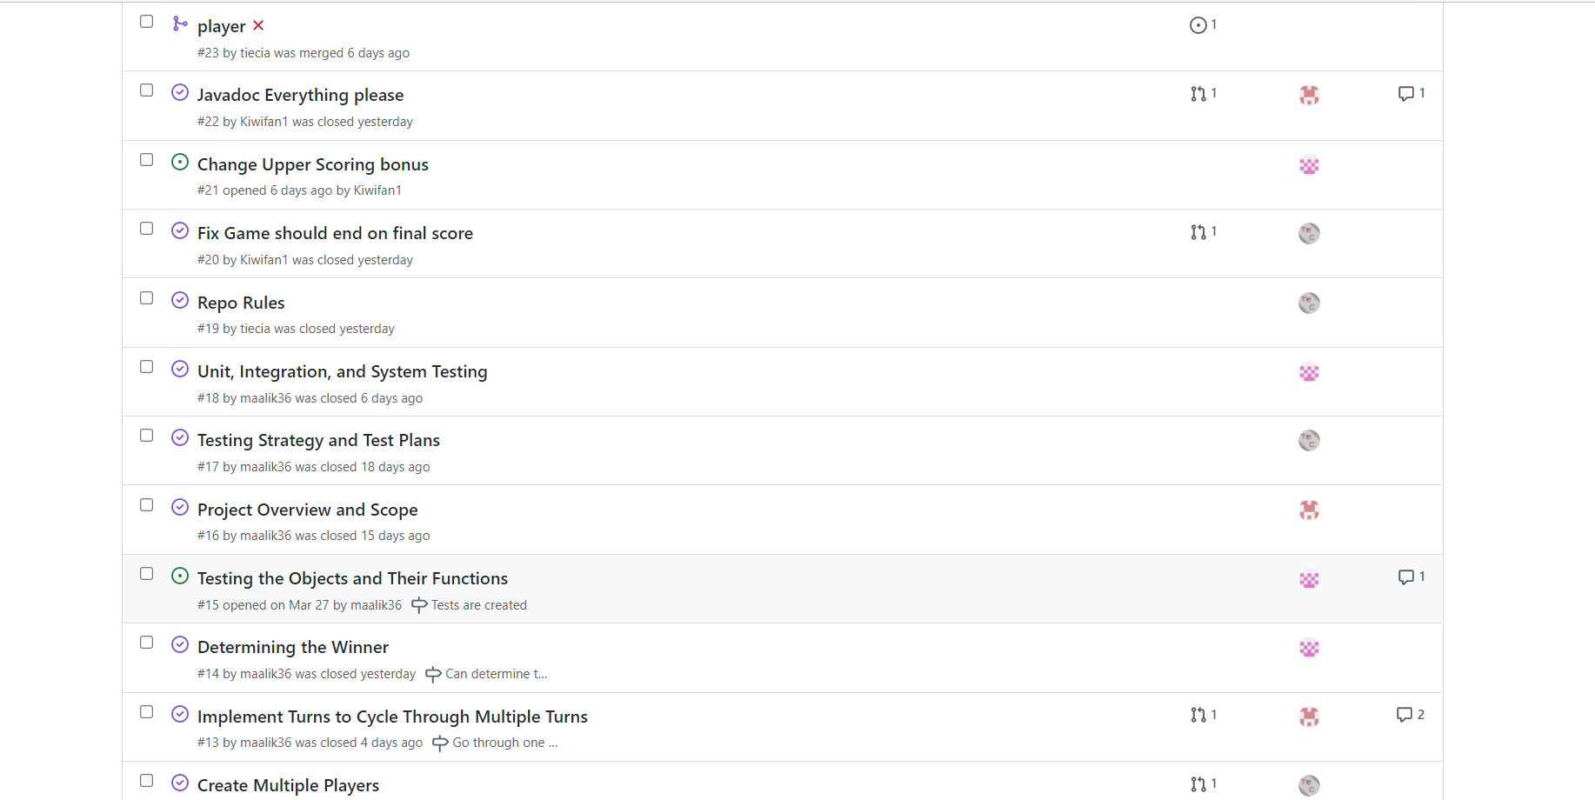
Team Collaboration Approaches
Discord
Git issues
Branching
Any lessons learned
Team collaboration
Utilizing source control
Hacking/discussion sessions
Notes:
Maalik
Git issues good at assigning tasks and alerting of assignment and completion of tasks.
Branching divided work efficiently without messing up main code

Slide 8
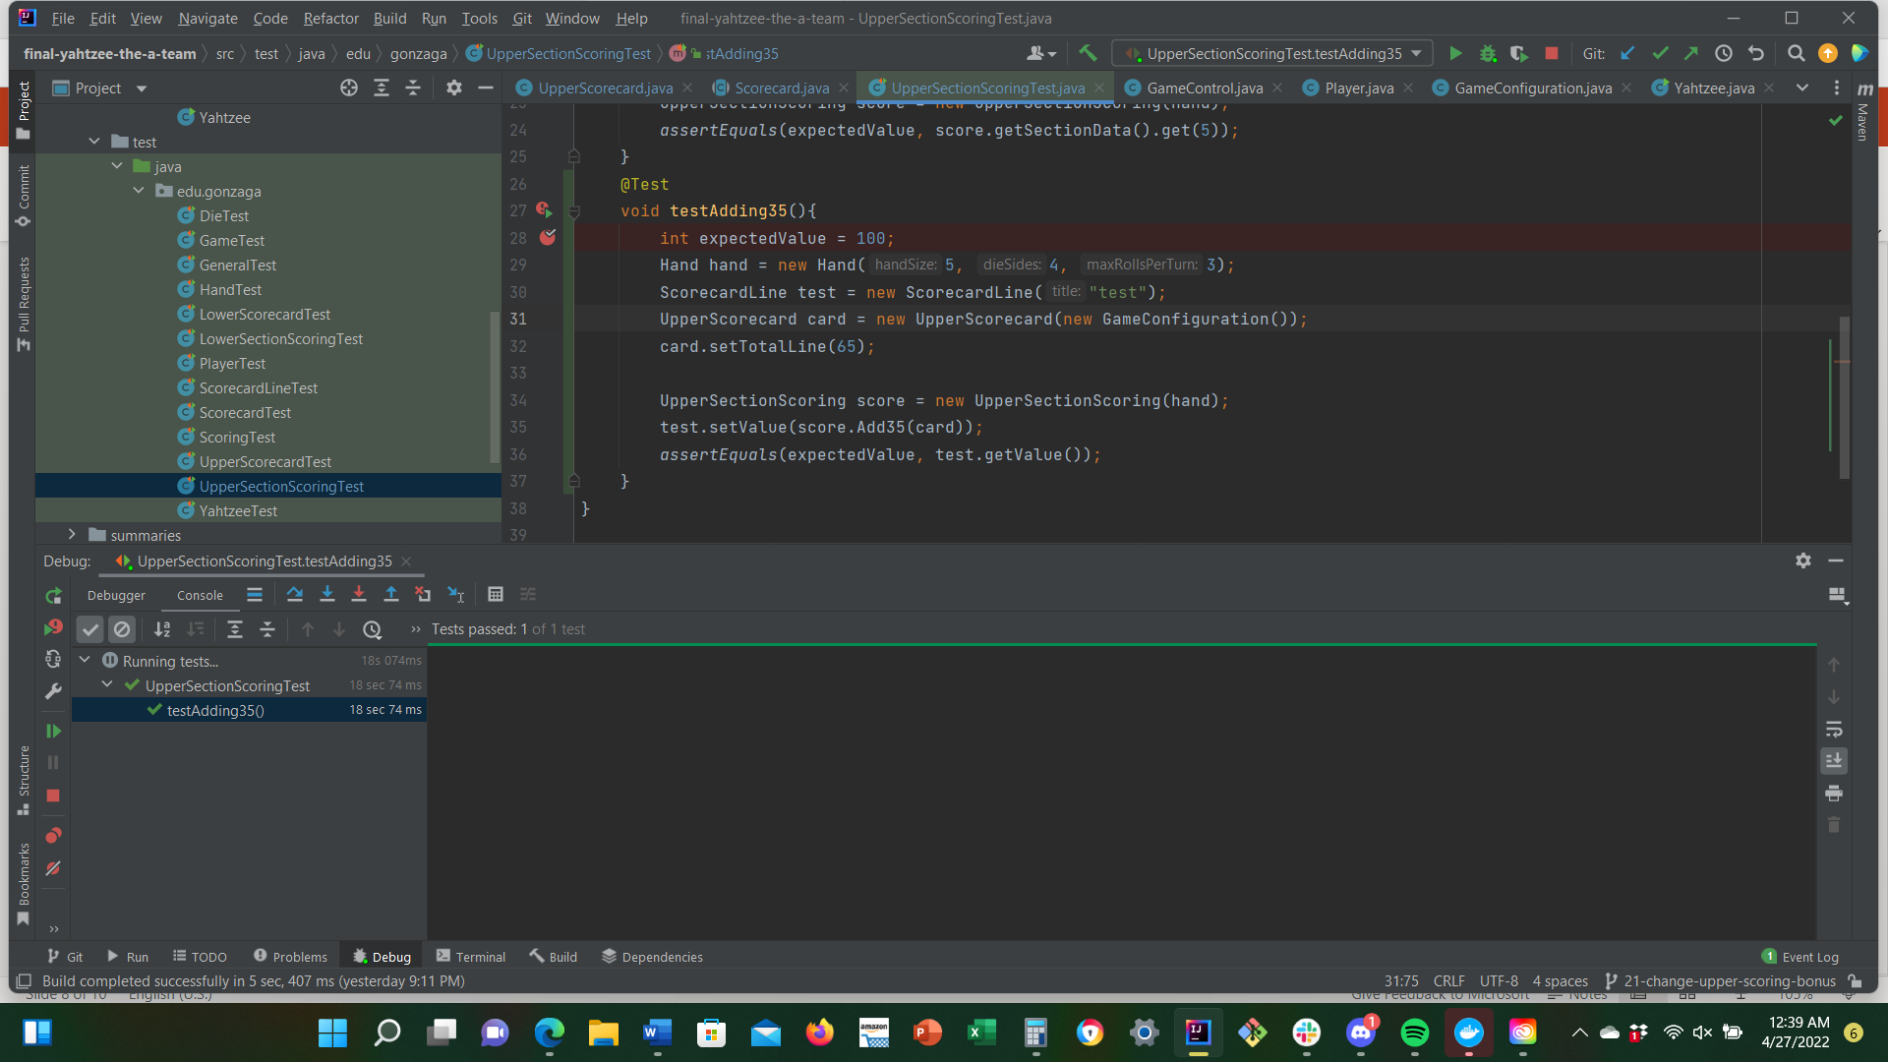
Testing, Validation, and Acceptance Plan
Unit tests for non-view classes
Integration tests for the relationships
Functional tests for reproduction and accuracy
User acceptance tests
Notes:
Maalik

Slide 9
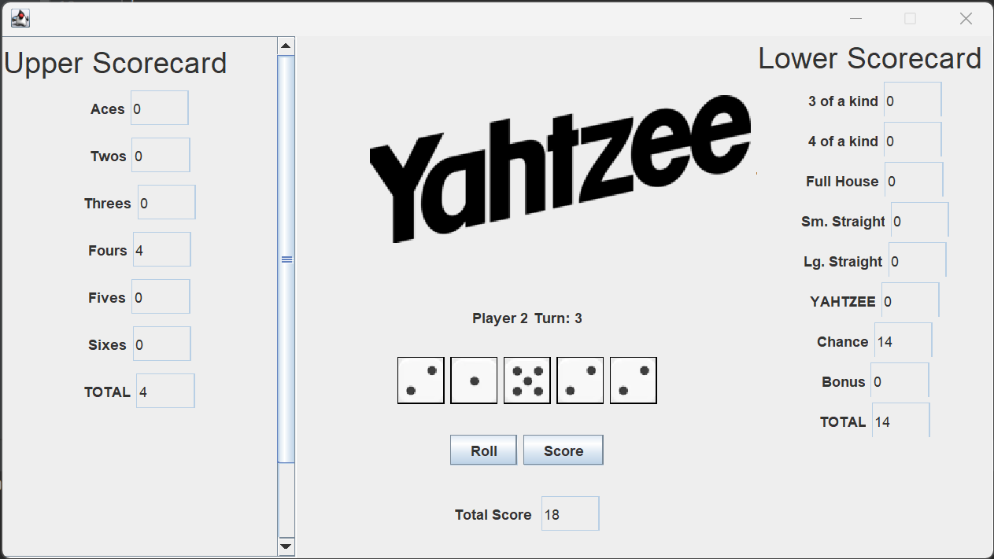
Live Demo Time - Take a minute or two
Notes:
Tyler

Slide 10
Summary
Lessons learned:
How to branch
How to better work on team projects using GitHub
How property change fires happen
Notes:
Maalik

